Slide 1
SSU
“Focus Areas Universe”
Arts & Humanities
Education
Social Sciences
Savannah State Majors
AS Core Curriculum
AA Core Curriculum
BS Chemistry
BS Forensic Science
BS Civil Engineering Technology
BS Computer Science Technology
BS Electronics Engineering Technology
BS Biology
BS Environmental Science
BS Marine Science
BS Mathematics
BSED Education
BS Political Science
BS Behavior Analysis
BS Criminal Justice
BA Sociology
BA Visual and Performing Arts
BA Mass Communications
BA English Language and Literature
BA History
BA Africana Studies
BA Homeland Security and Emergency Management
Bachelor of Social Work (BSW)
Bachelor of Interdisciplinary Studies (BIS)
BBA Computer Information Systems
BBA Management
BBA Marketing
BBA Accounting
BBA Global Logistics and International Business
8, 11, 12, 14, 17
2, 6, 12, 13, 15, 16, 17, 18, 19, 20, 21, 24, 27
1, 2, 4, 12, 13, 14, 15, 16, 18, 20, 21, 22, 23, 24, 26, 27, 29
Policy &
Public Service
4, 5, 9, 13, 15, 20, 21, 22, 23, 26, 28, 29
Business
Health &
Human Services
5, 6, 7, 25, 26, 27, 28, 29
1, 2, 8, 14, 23
STEM
1, 3, 4, 5, 6, 7, 8, 9, 10, 11, 12, 14, 18, 22, 24, 25, 28

Slide 2
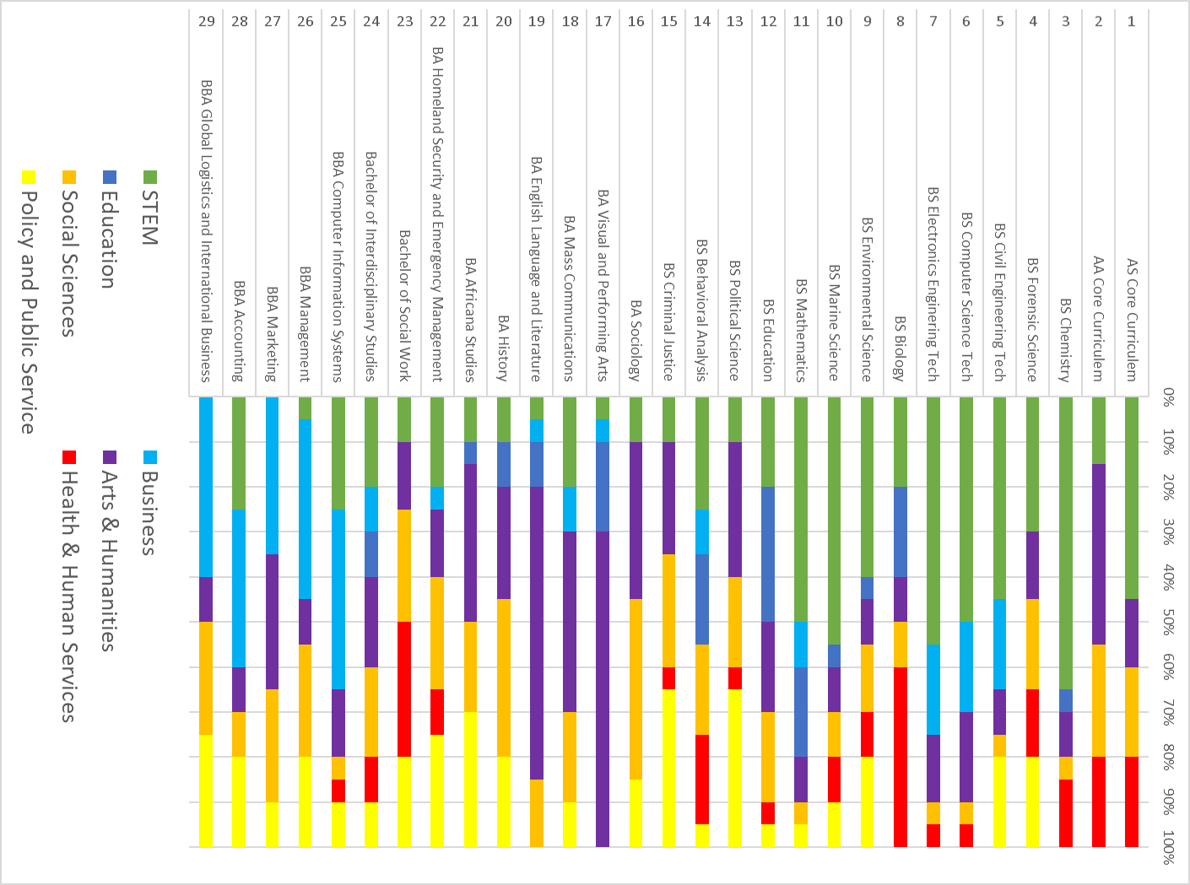

Slide 3
The SSU Meta-Majors Universe
Education
Natural Sciences
SSU Majors
AS Core Curriculum
AA Core Curriculum
BS Chemistry
BS Forensic Science
BS Civil Engineering Technology
BS Computer Science Technology
BS Electronics Engineering Technology
BS Biology
BS Environmental Science
BS Marine Science
BS Mathematics
BBA Computer Information Systems
BBA Management
BBA Marketing
BBA Accounting
BA Sociology
Bachelor of Social Work
BS Political Science
BS Behavior Analysis
BS Criminal Justice
BA Visual and Performing Arts
BA Mass Communications
BA Homeland Security and Emergency Management
BA English Language and Literature
BA History
BA Africana Studies
BS Education
Bachelor of Interdisciplinary Studies
BBA Global Logistics and International Business
Arts
STEM
27
8
10
21
Social Sciences
9
3
24
25
28
11
Health Sciences
2
1
26
19
17
4
5
16
7
22
14
18
23
6
29
12
15
20
13
Humanities
Business
Government, Law, and Policy

